Slide 1

PREDICTING EMPLOYEE ATTRITION USING RANDOMFOREST
This Photo by Unknown author is licensed under CC BY-SA.

Slide 2

Predicting Employee Attrition using random forest
TEAM NO: CSE 048
Submitted by
Divya sri
LaxmiPriya Chowdary
Divya Vuppula
Pulicherla Pranavi
This Photo by Unknown author is licensed under CC BY.

Slide 3
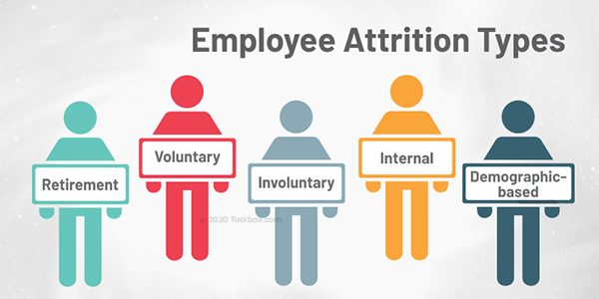
What is Employee attrition
Employee Attrition is the gradual reduction in staff numbers that occurs as employees retire or resign and are not replaced. Employee attrition can be costly for businesses. The company loses employee productivity, and employee knowledge.

Slide 4
Data Source
For this project 'Employee Attrition' has been picked ,which is available on dataset websites
This data consists records of 1,470 employee
Information about employee’s current, employment status, the total number of companies worked for in the past, Total number of years at the current company and the current roles, Their education level etc.

Slide 5

Describe the dataset
A data set is an ordered collection of data. While handling the data, the data set can be a bunch of tables, schema and other objects
The data describes about the attrition, Job Level, JobRole, TotalWorkingYears, Training TimesLastYear, accuracy rate

Slide 6
Steps
Import Libraries and read data
Describe the dataset
Data Transformation
Data Cleaning and Feature Selection
Split the dataset into train and test set
Machine Learning Modeling
Train the model (fit)
Test the trained model
Model Evaluation

Slide 7

Import Libraries and read data set
** Import some libraries that will be used throughout the program.**
import numpy as np
import pandas as pd
import seaborn as sns
import matplotlib.pyplot as plt
This Photo by Unknown author is licensed under CC BY-NC-ND.

Slide 8
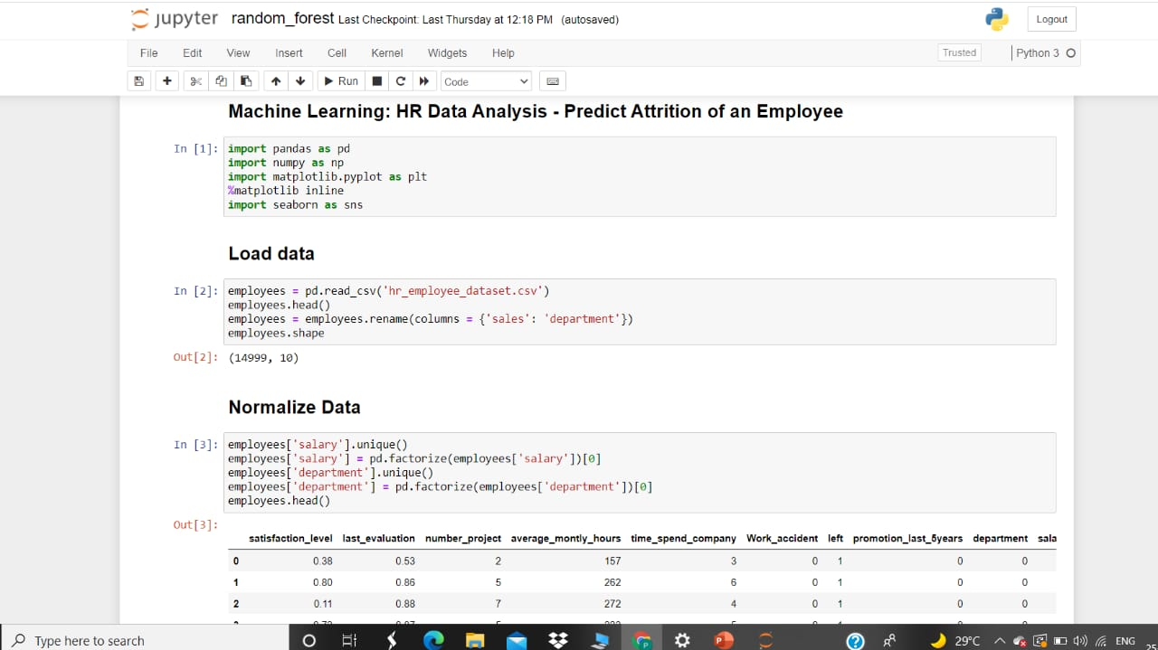
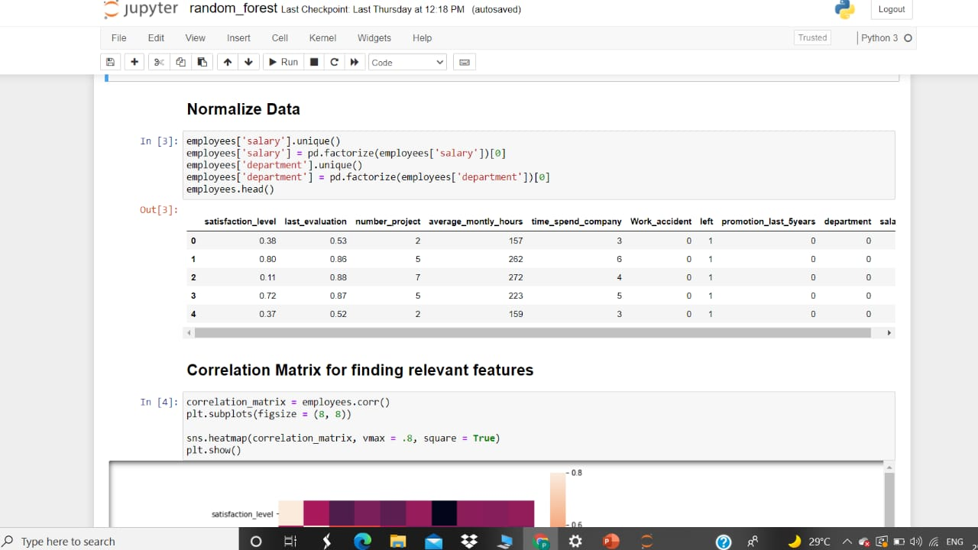
Click to text

Slide 9
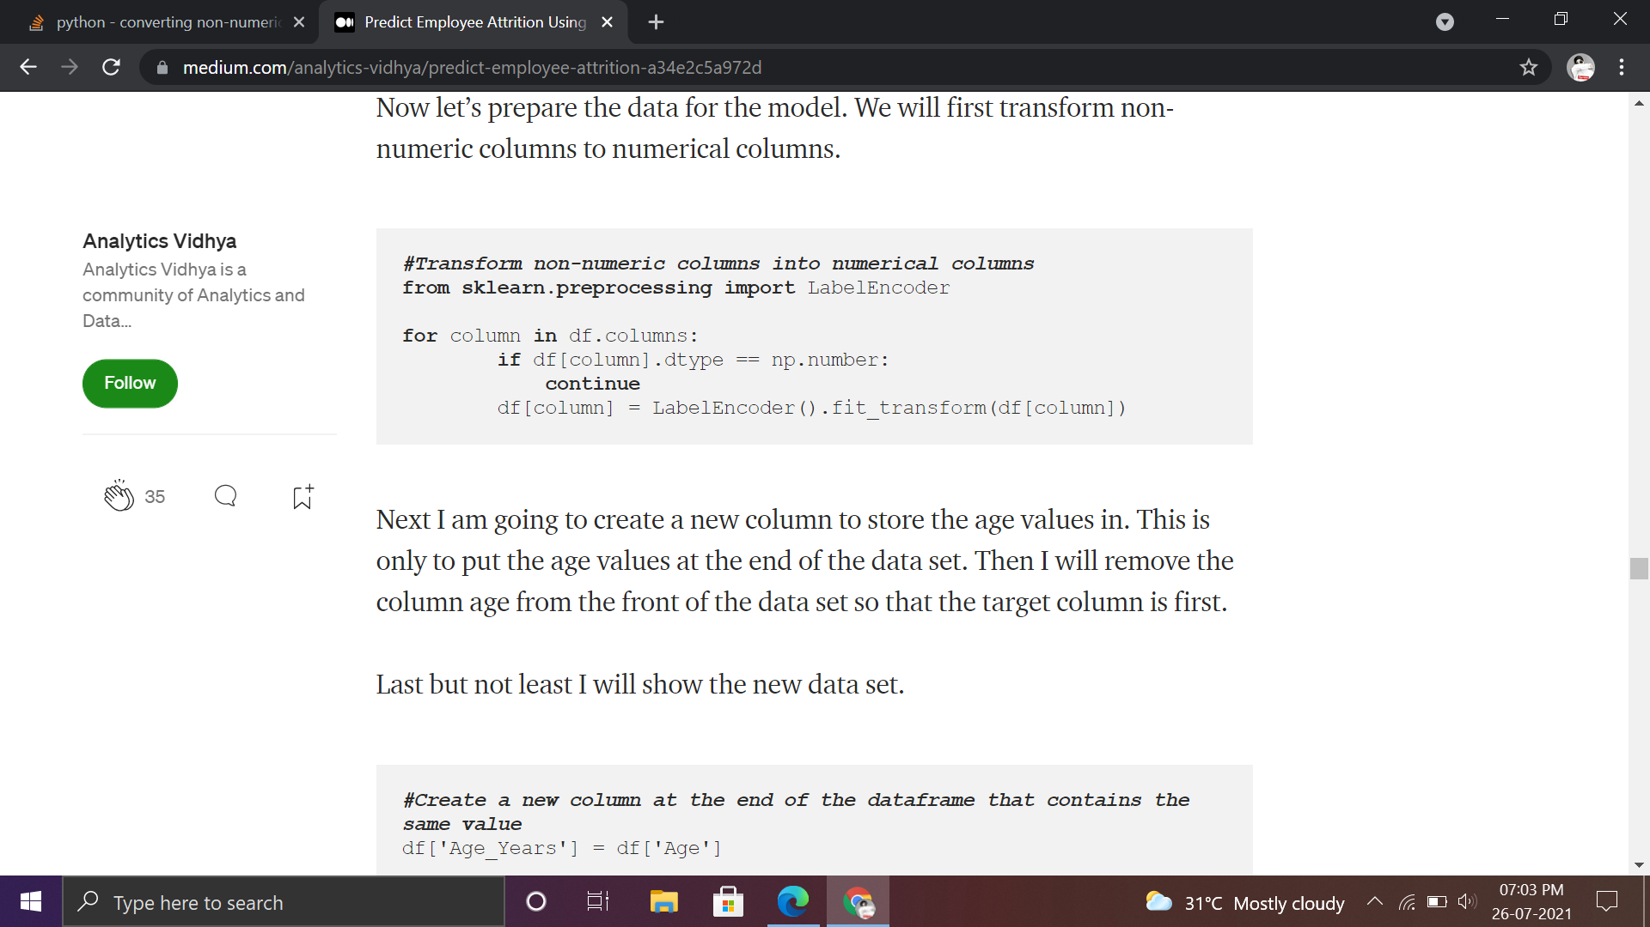
Data Transformation / Categorical to Numerical
*Here the data is convert nonnumerical values into numerical values
*Data Cleaning and Feature Selection
Data cleaning is the process of fixing or removing incorrect, corrupted, incorrectly formatted, duplicate, or incomplete data within a dataset.
df.isnull().any()

Slide 10
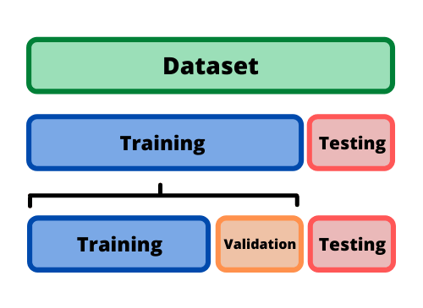
TRAINING AND TEST DATA
Split the dataset into train and test set
* Train/Test is a method to measure the accuracy of your model.
*Training data sets are sets on which you train your machine i.e algorithm to form relationships between variables.
*Testing data set helps you to validate that the training has happened efficiently in terms of either accuracy, or precision so on.

Slide 11
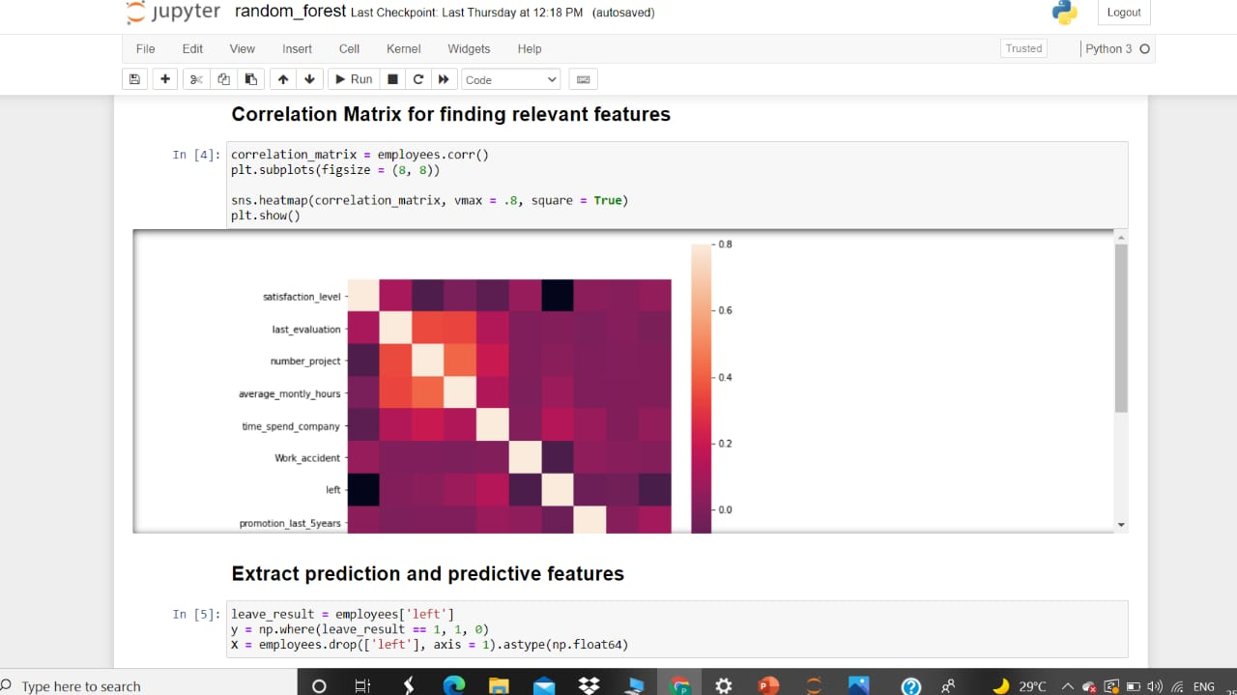
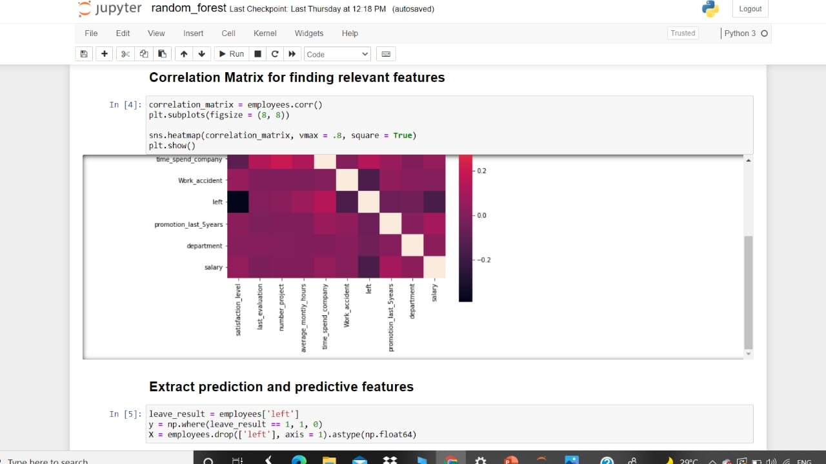

Slide 12
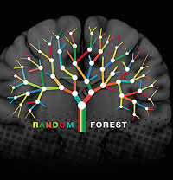
Random forest
Random forest algorithm is a supervised classification algorithm.
More trees in the forest the more
robust the forest looks like.
Same way in random forest classifier, the higher the number of trees in the forest gives the high accuracy results.

Slide 13
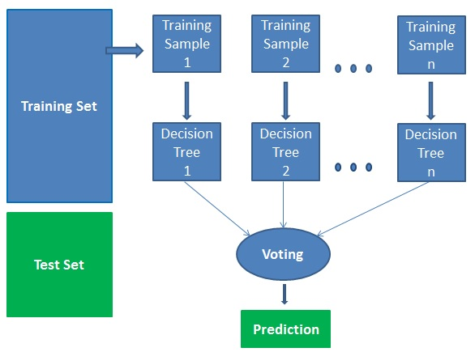
How does the algorithm work?
It works in four steps:
Select random samples from a given dataset.
Construct a decision tree for each sample and get a prediction result from each decision tree.
Perform a vote for each predicted result.
Select the prediction result with the most votes as the final prediction
random forest algorithm

Slide 14
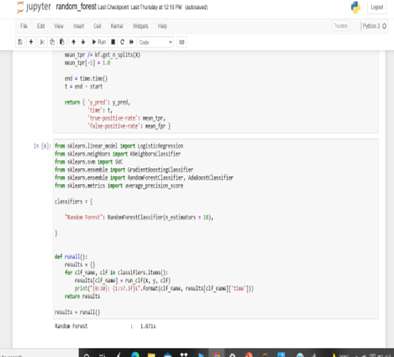

Slide 15
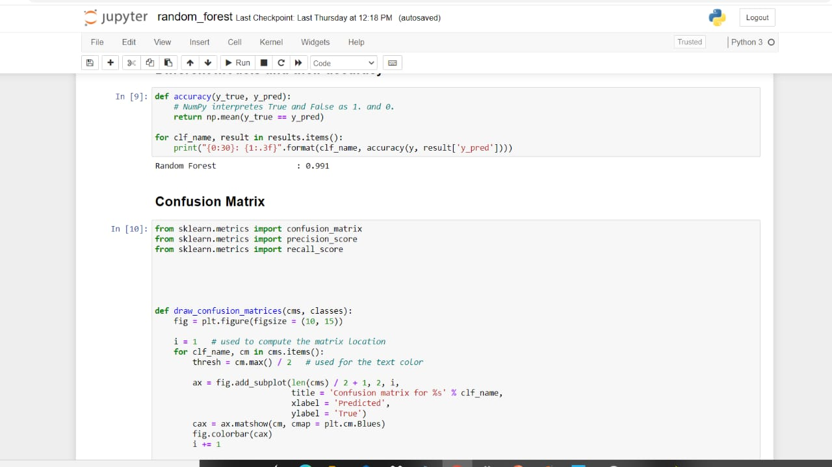
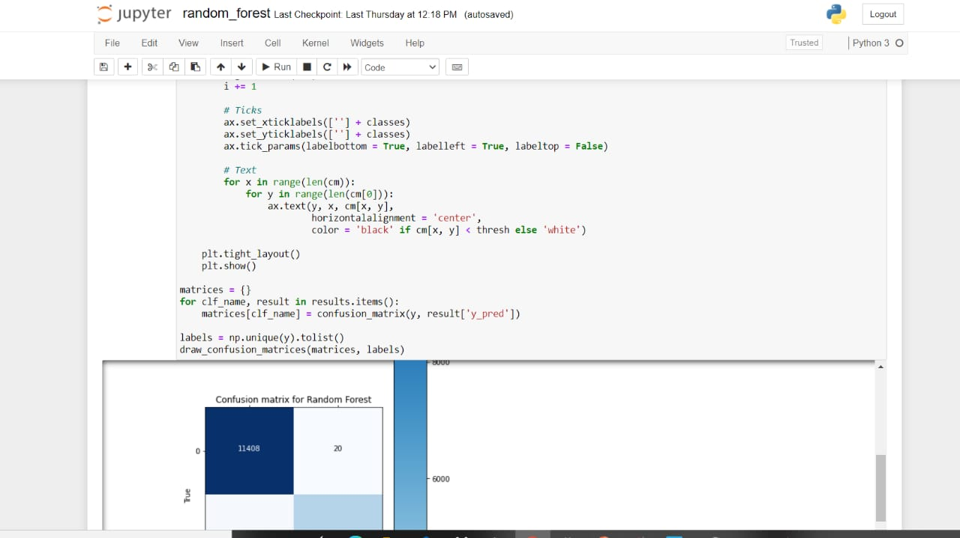

Slide 16
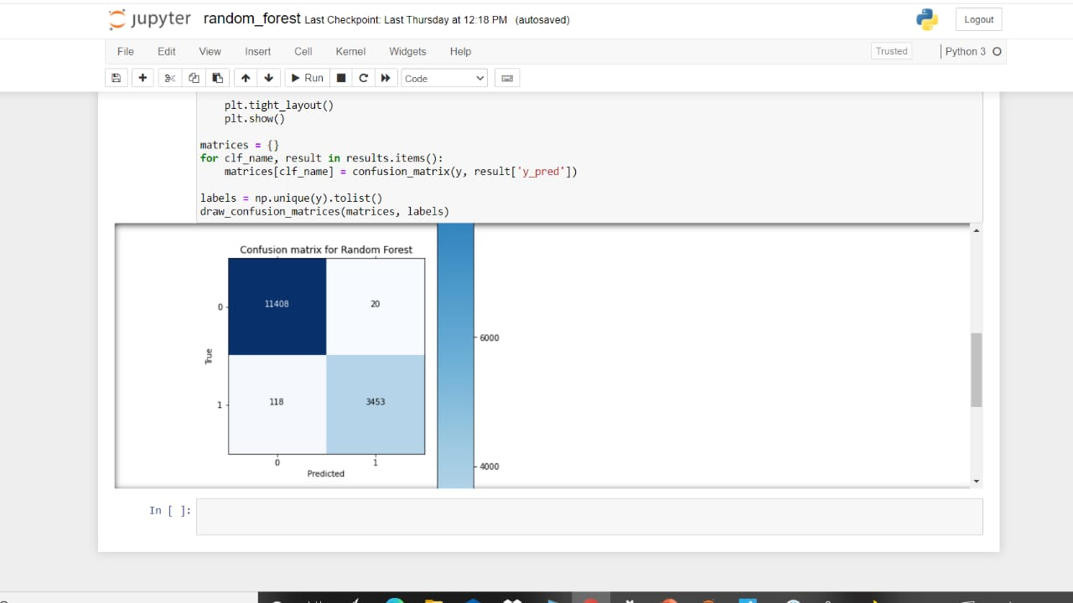

Slide 17
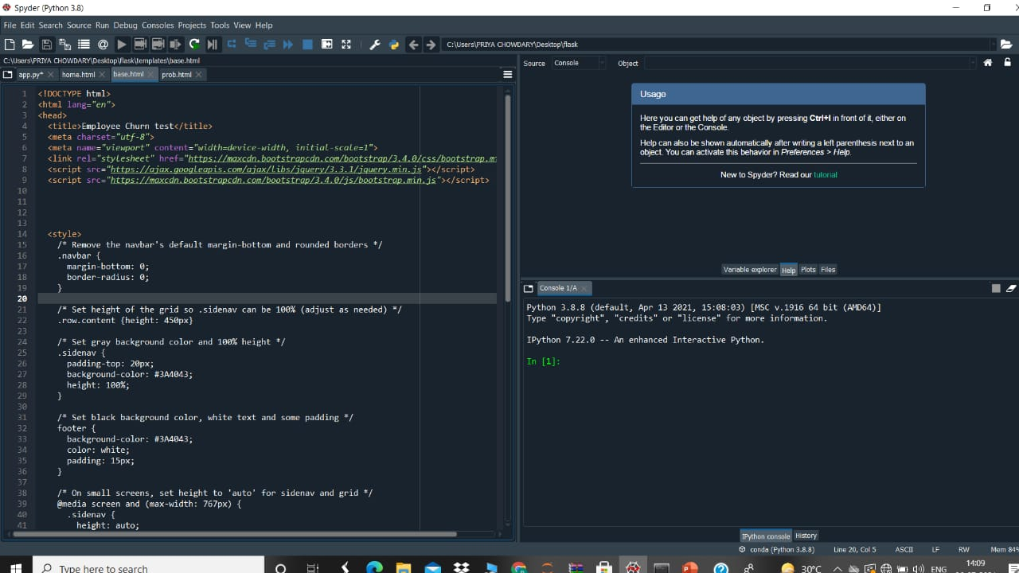

Slide 18
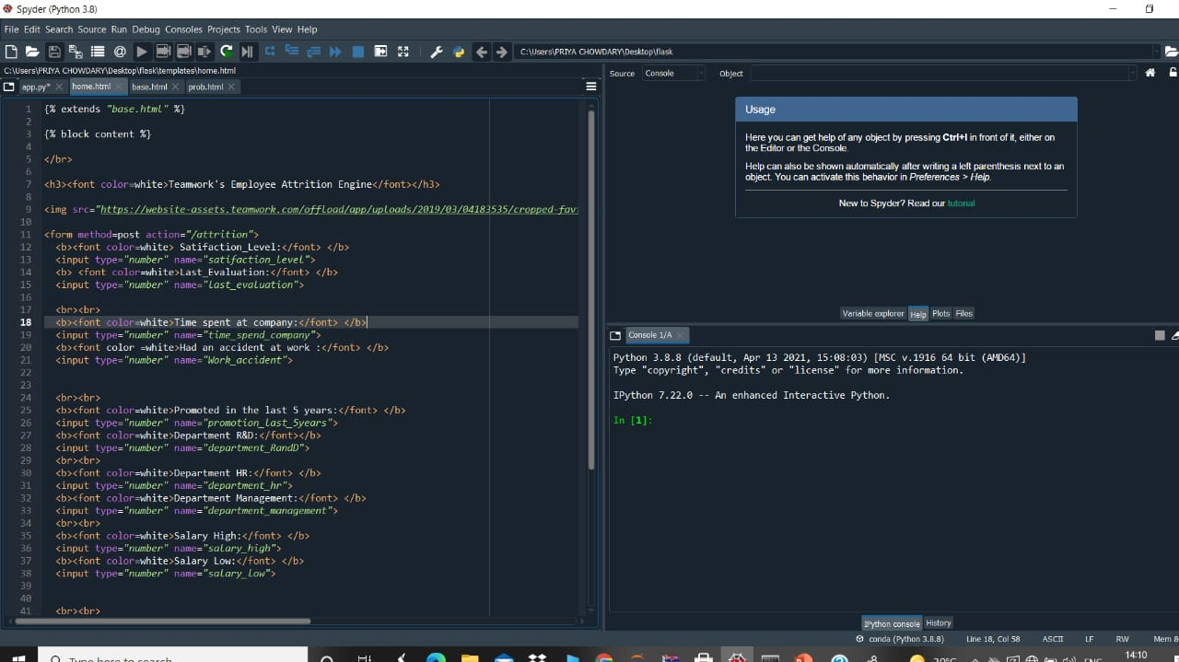

Slide 19
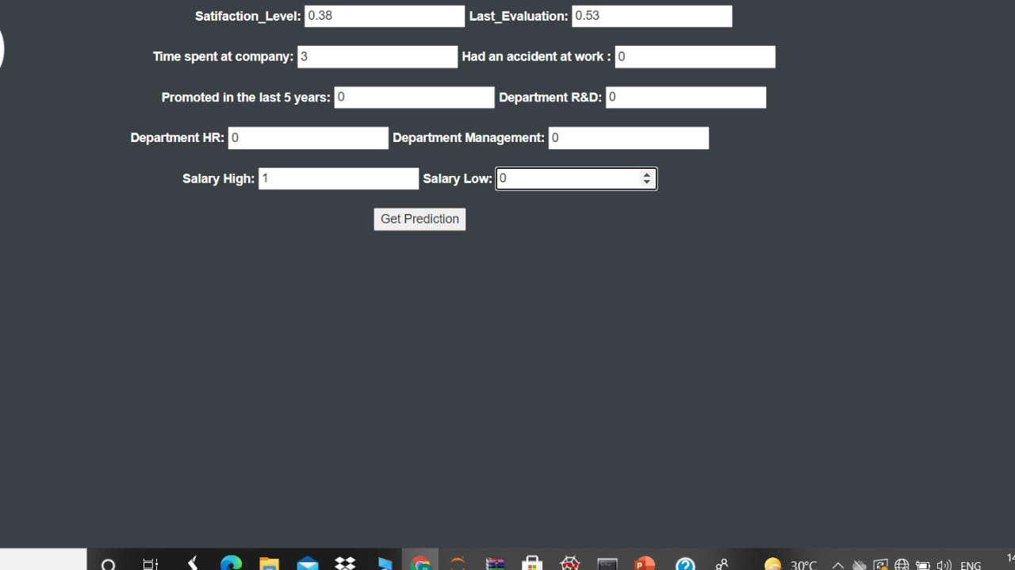

Slide 20
Conclusion
The project predicting employee attrition I conclude that Attrition cannot be removed but it can be reduced . If initiative is taken towards this steps ,as per the recommendation of this research,then the attrition rate can be lowered ,so that the expenditures towards hiring and training an new joiner which exceeds the cost of retaining an employee can be drastically brought down

Slide 21

This Photo by Unknown author is licensed under CC BY-NC.

